Slide 1
How Smart Projects Review Welding Procedure Specifications
February 9, 2022
Notes:
Hi, I am Roy. Thank you for attending today’s presentation How Smart Projects Review Welding Procedure Specifications.

Slide 2
Communication
The Project Management Institute’s (PMI’s) report The Essential Role of Communication states: ineffective communication has a negative impact on project success >50% of the time.
Communication and understanding are key
to project success
Notes:
Various project roles have different communication challenges. This was demonstrated to me by experience as a welder, inspector, and coordinator.

Slide 3
WPS Applications
Welding procedure specifications (WPSs) are used for:
Instrumentation
Pressure piping
Pressure vessels
Structures.
Service conditions may be:
As-welded or post weld heat treatment (PWHT) condition
Standard or low temperature
Sweet or sour service.
Notes:
WPS reviews occur during detailed engineering when personnel are busy. Will WPS reviews be value-added or a waste of the project’s valuable resources? Who knows?

Slide 4
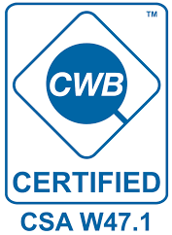
Certified WPSs Are Required
Certified WPSs are required per the code of construction, regulations, standards, or a combination.
WPSs may be reviewed by a project to ensure production welding meets additional requirements; owner specifications, if any.
Notes:
The equipment may be exported or imported. Requirements for the production and installation of equipment in other jurisdictions may be different or similar.

Slide 5
Ask these Questions about WPSs
A project that does not answer these questions risks inadequate or inappropriate WPS reviews:
Which WPSs should be reviewed?
How WPSs should be reviewed?
Who should review WPSs?
Miscommunication and
misunderstanding frustrate
project success
to project success
Notes:
Thinking that personnel will figure this out at some point is a lazy attitude and not proactive. These requirements should be established at the start – not when WPSs begin piling up!

Slide 6
A WPS is a Recipe
A WPS is a recipe that addresses essential, non-essential, and supplementary essential variables for production welding.
Like any recipe, a WPS identifies the ingredients (e.g., base metals, consumables, and processes).
Notes:
Welding knowledge has been established for decades but codes, regulations, and standards are subject to change, and new knowledge is always being developed.

Slide 7
A WPS is Like a Cake Recipe
A WPS is like a cake recipe. A cake recipe may make a great cake - but what about appropriateness and context?
The next table lists recipes for two cakes.
Notes:
What measurements does the baker use? The left recipe uses imperial, and the right recipe uses metric. Are the unit conversion correct (the left is the original)? Check my work!

Slide 8
A WPS is Like a Cake Recipe
The occasion and cake recipient determine if the cake is appropriate.
Delivering a race car birthday cake to a wedding is neither appropriate nor a success!
WPS review is similar. Success may only be achieved by first acquiring adequate information and detailed requirements.
Notes:
This merely scratches the surface. What other requirements could a cake recipient have (e.g., eggless, dairy-free, ice cream, or low-sugar) and how shall a cake be decorated?

Slide 9
1. Which WPSs Should be Reviewed?
Requirements for WPS review may be identified by:
A corporate or project instruction
Best practices, experience, and knowledge
What other similar projects have used
A combination – which is recommended.
Notes:
If no process is established, personnel will be forced to answer these questions later, and individually, using their own abilities and assumptions. Results will be inconsistent, at best!

Slide 10
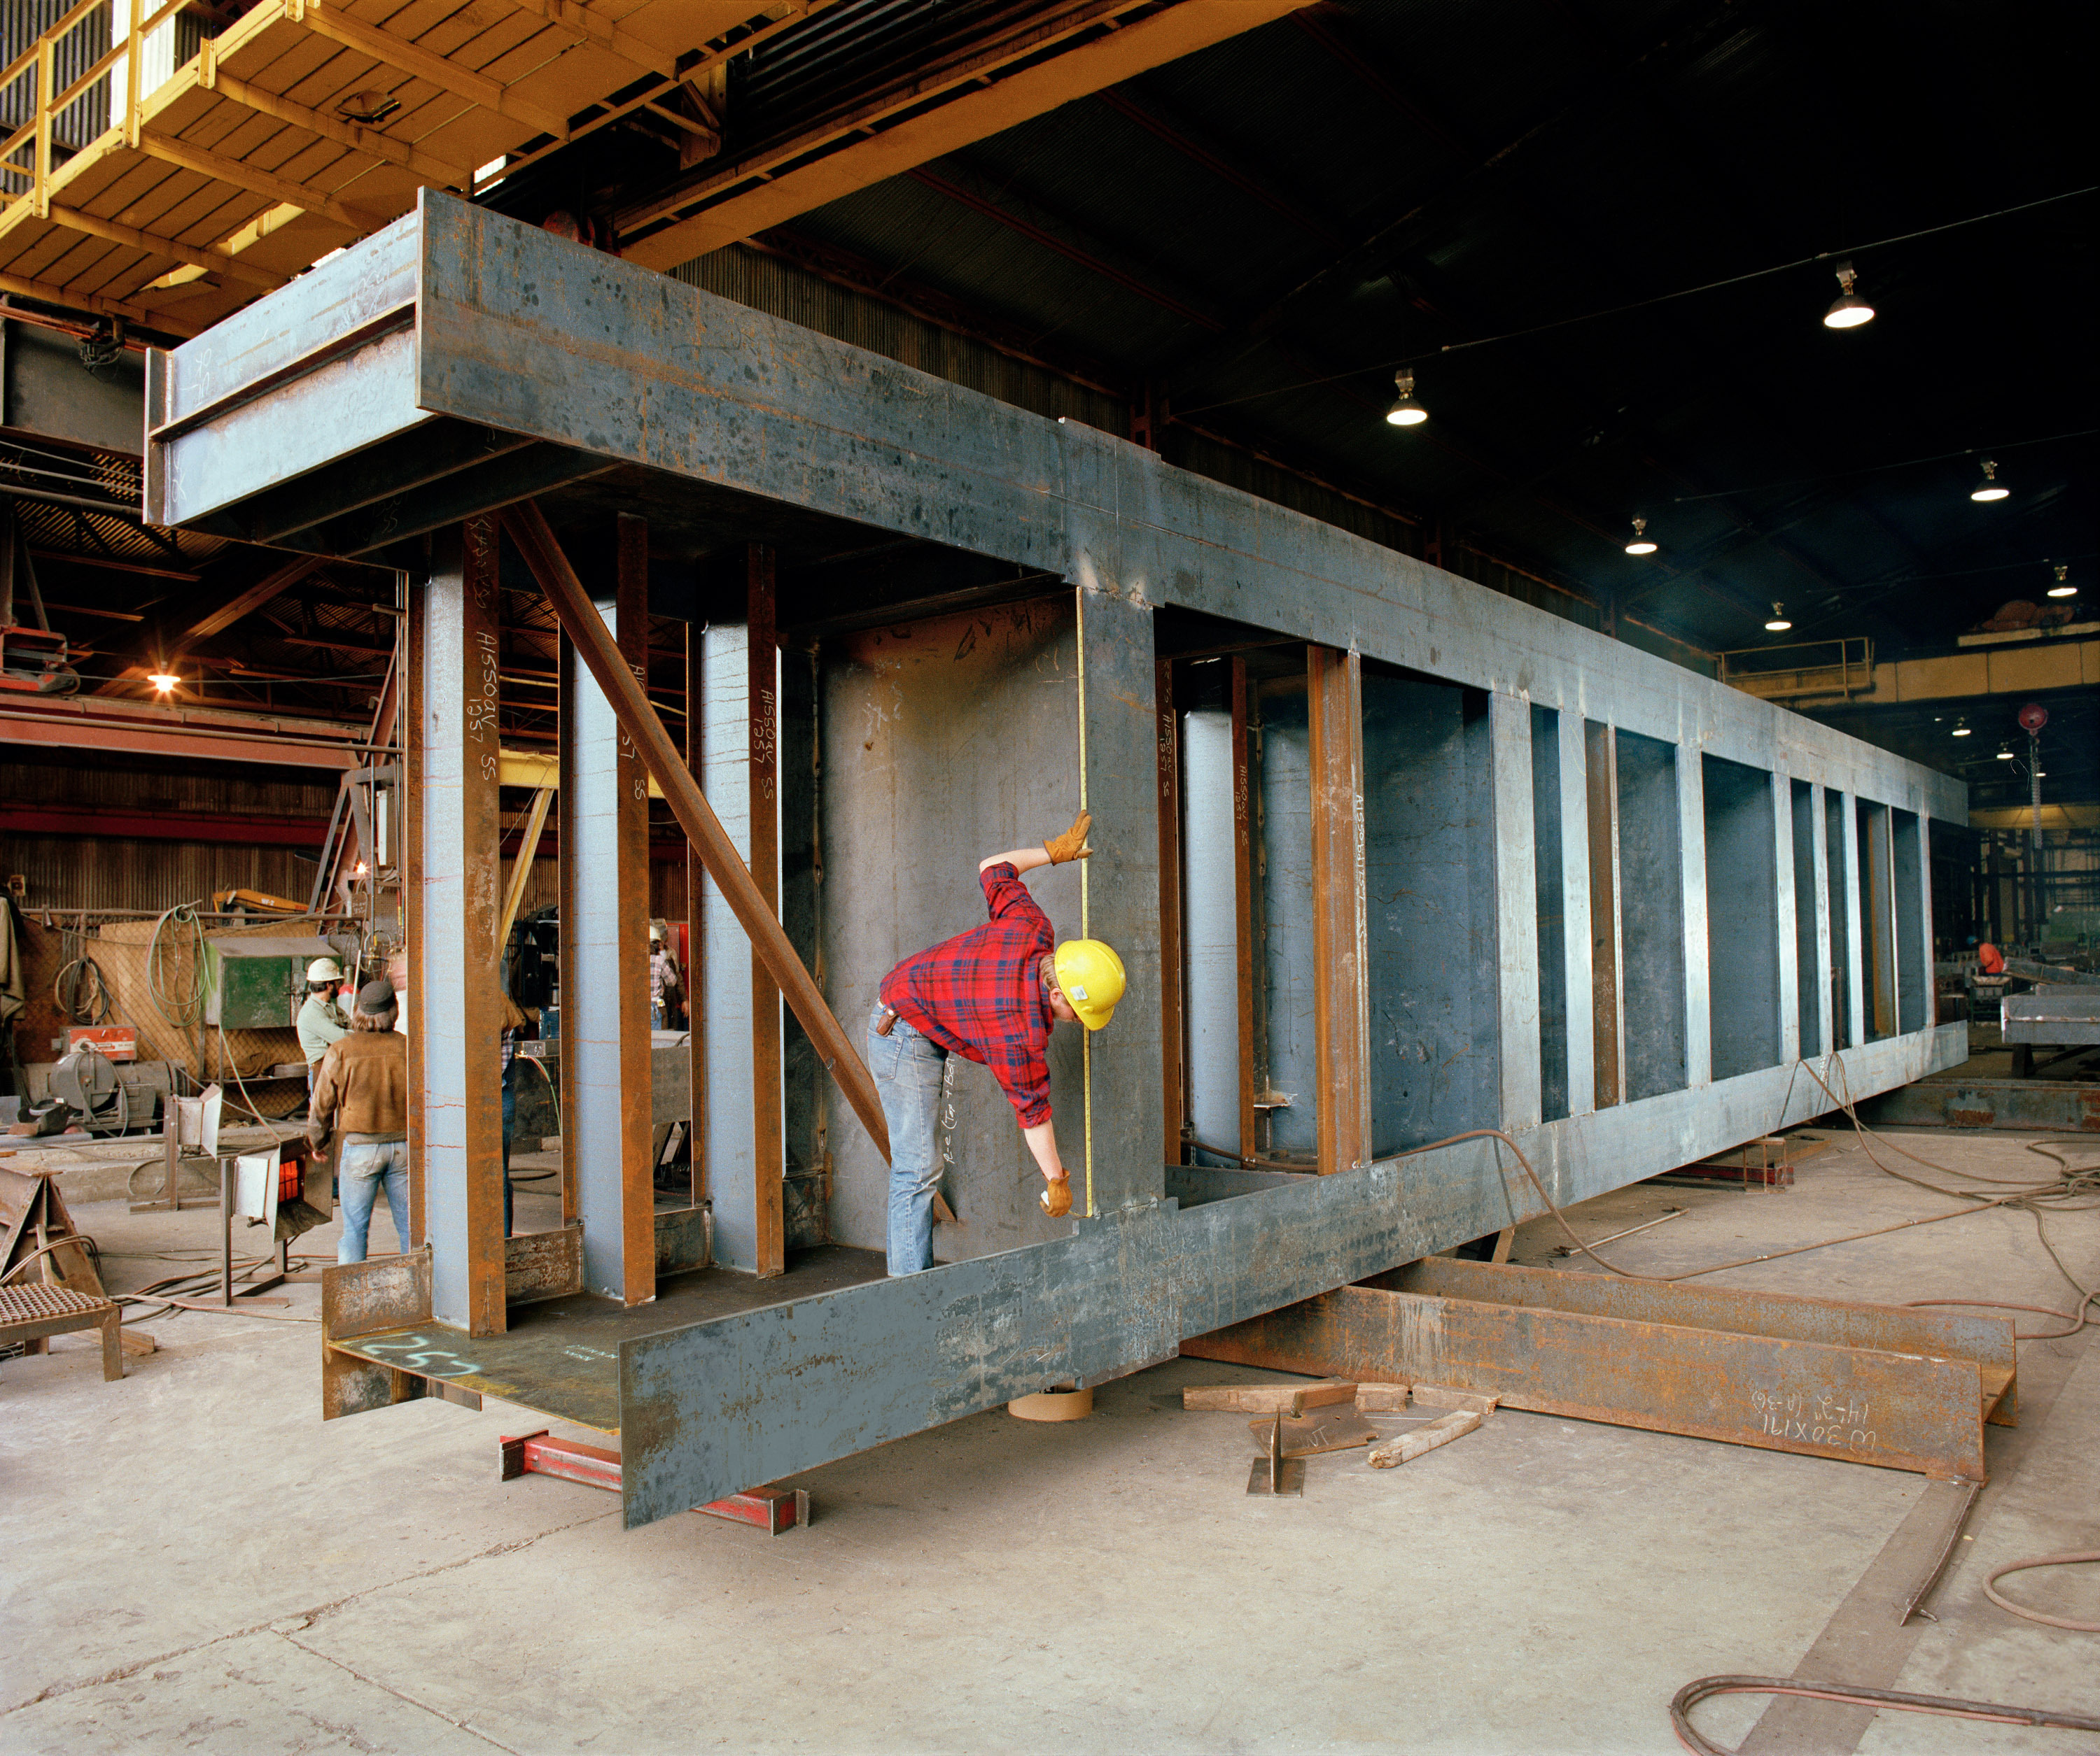
1. Which WPSs Should be Reviewed?
For effective and efficient WPS reviews, a project should provide clear instructions determined by equipment:
Complexity – standard or non-standard
Cost – equipment value
Criticality – consequence of failure.
Notes:
A project may mandate that all, none, or specific WPSs shall be reviewed. Historical suppliers with experienced personnel and standard products may need less oversight.

Slide 11
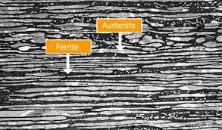
1. Which WPSs Should be Reviewed?
Other considerations may include the project and supplier personnel’s expertise and their understanding of project equipment.
Ask: Are there project-specific welding requirements or specifications?
If no: all or some WPS reviews may be omitted to save money and time
If yes: all or some WPSs may need to be reviewed.
Notes:
Will established or new technology be used? As an alternative, a supplier’s ABSA or CWB certificate may be submitted for review and record instead of their WPSs.

Slide 12
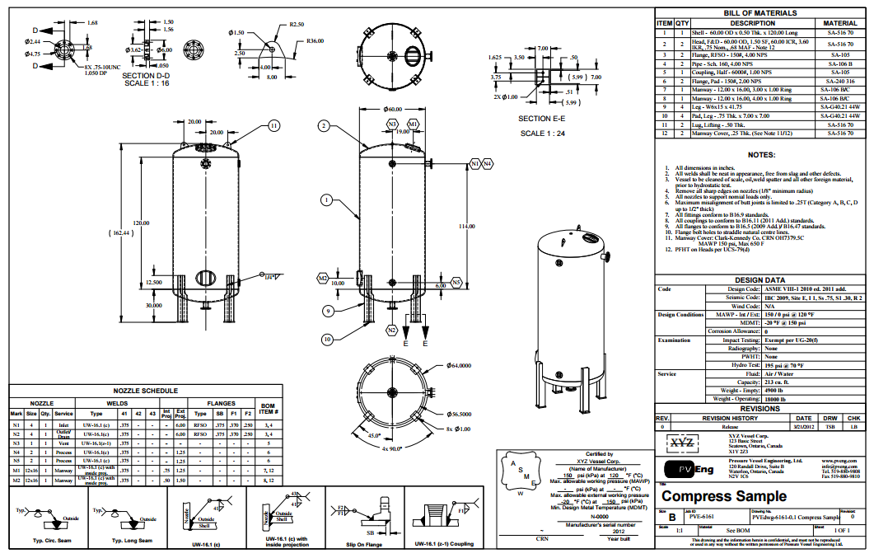
2. How Should WPSs be Reviewed?
A project may have dozens or hundreds of WPSs that require review. Each WPS may comprise a few or dozens of pages.
To properly review a WPS, the reviewer needs details about the application, code of construction, and other information including:
Procurement documents
Production drawings
Specifications and standard drawings.
Notes:
A WPS cannot be reviewed completely and properly with inadequate information. That is like baking a cake without knowing the occasion or recipient!

Slide 13
2. How Should WPSs be Reviewed?
Acceptable methods for reviewing WPSs include the following:
For record only obtains WPSs for information and no review is required
A summary review verifies the WPS is appropriate for the application, and is complete and correct (e.g., 1-hour review)
A comprehensive review is a line-by-line review for verification of all WPS details and variables, including procedure qualification records (PQRs) and attachments, to verify compliance for all code of construction, project specification, and other requirements (e.g., 4- to 8-hour review)
An inspection review is performed by the third-party inspector as a quality verification point (QVP) in lieu of or with a project review.
Notes:
What are the benefits and risks to be addressed by WPS review? What requirements should be verified? What resources are available to perform the task?

Slide 14
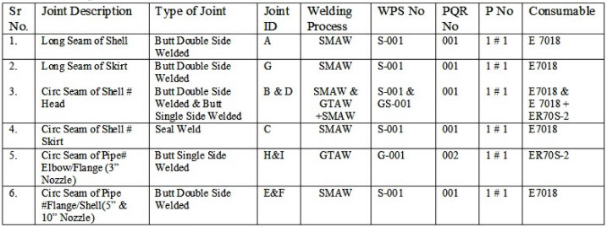
2. How Should WPSs be Reviewed?
A weld map or WPS summary is a useful matrix that together with WPSs:
Details how and where each WPS will be used
Verifies the supplier understands their scope of supply and welding requirements.
Production drawings may
include this information.
Notes:
A weld map or WPS summary makes the review process quicker and easier (saves money and time). Some suppliers will have multiple WPSs, so ad hoc review can be confusing.

Slide 15
3. Who Should Review WPSs?
A qualified WPS reviewer has:
A diploma in material or welding engineering technology
A post-graduate degree in material or welding engineering
Certification as a welding engineer, inspector, or procedure reviewer
Experience and knowledge
Training for welding inspection or standards
A combination of the above.
Third-party services may be obtained if there are inadequate resources.
Notes:
Someone who does not work with welding daily may not be a suitable resource. If needed, a service provider agreement should be prepared at the start – not when WPSs begin piling up!

Slide 16
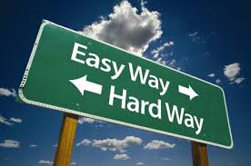
Conclusion
A smart project ensures that WPS reviews are completed with a documented process that establishes:
Which WPSs should be reviewed
How WPSs should be reviewed
By whom WPSs should be reviewed.
Communication and
understanding are key
to project success
Notes:
The easy way is to document the WPS review process and its requirements. The hard way is to let everyone figure it out.

Slide 17
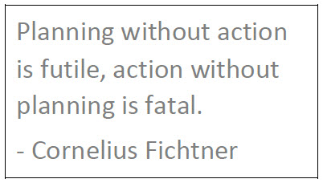
Conclusion
Established processes avoid confusion, misunderstanding, rework, and waste associated with WPSs that are reviewed ad hoc or randomly.
Too many projects have informal, disjointed WPS review processes that rely on the very unscientific hope that the reviews will meet project needs.
Leaving important details to chance is always a bad idea.
Chance favors the prepared. Prepare a plan.
Then, execute the plan.
Notes:
A smart project will document best practices and lessons learned from WPS reviews and transfer this knowledge to the next project and other personnel.

Slide 18
Learn More
To learn more about project success, see these resources:
ebook: The Key to Project Success
Article: How Smart Projects Review Welding Procedure Specifications
Fact sheet: Top Five Challenges and Solutions for Reviewing WPSs (document)
Fact sheet: Top Five Challenges and Solutions for Reviewing WPSs (graphic)
Notes:
The article How Smart Projects Review WPSs was published in the CWB WELD magazine’s winter 2021 edition.

Slide 19
Q&A
Questions?
Comments?
Concerns?
Notes:
I am available to discuss your feedback now or later. A copy of this presentation is available on request.

Slide 20
Presented by
Roy O. Christensen, RET, CWB Level 3, API 510, ABSA IPV&PPI
hello@ktproject.ca
+1 403.703.2686
www.ktproject.ca
Notes:
Thank you for your attention!

Slide 21
Supplemental
The KT Project glossary (see inset) reduces the risk of miscommunication and misunderstanding in project settings.
To learn more, see: Successful Projects Need Effective Communication.
Notes:
Why assume understanding and hope for the best or rely on Google? Make a glossary your single authority for company, industry, and project terminology.

